Slide 1
Computer Simulation
Module 2: Calculus, Probability, and Statistics Primers
Dave Goldsman, Ph.D.
Professor
Stewart School of Industrial and Systems Engineering
Great Expectations

Slide 2
Lesson Overview
Last Time: We took a brief detour to show how to simulate some easy random variables.
This Time: Back to the formal Probability Review. This module is all about expected values.
Pay particular attention to the LOTUS blossom that you'll soon see!

Slide 3
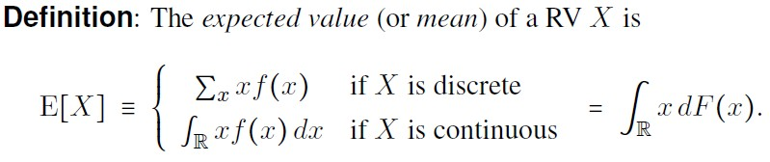
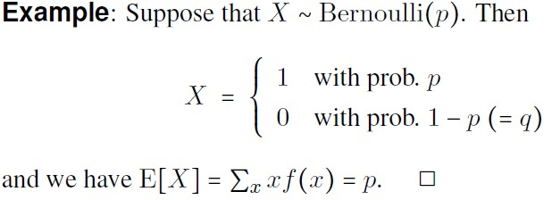
Notes:
Expected value is just a weighted average of the x values. dF(x) is just the two scenarios covered in the brackets.

Slide 4
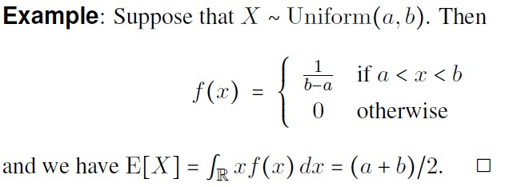

Slide 5
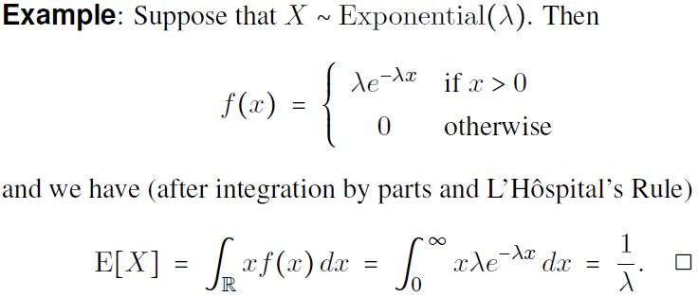

Slide 6
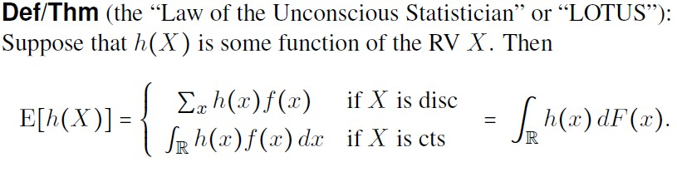

Slide 7
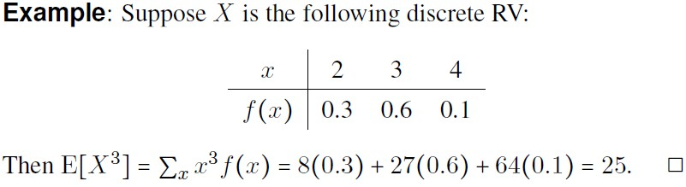
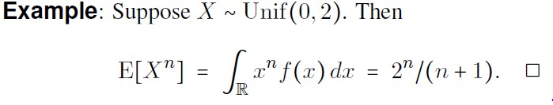

Slide 8

Notes:
Variance s the second central moment.

Slide 9
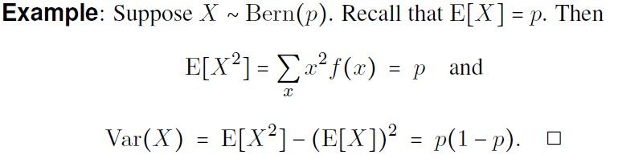
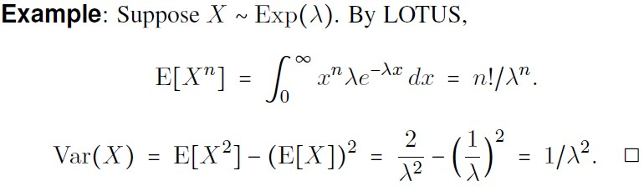

Slide 10
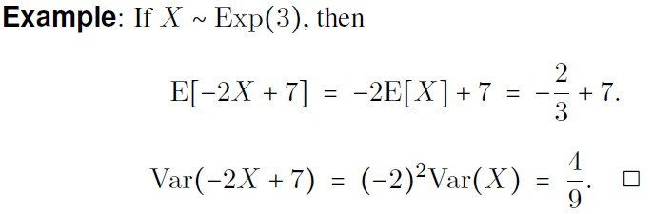

Slide 11
Just a Moment!
We’ve gotten through most of the good stuff with respect to expectations.
I’ll do one more topic – moment generating functions, which are useful for a variety of reasons.
This stuff is a little more challenging, so that’s why I’ve taken a little break.

Slide 12

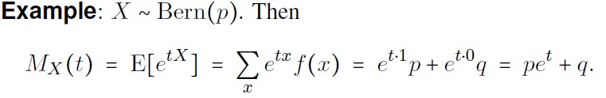
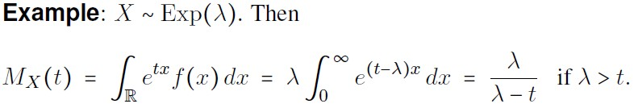

Slide 13
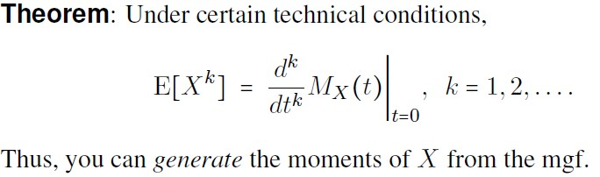
Notes:
You can get the m oments of X – by a function multiplied by the MxT. Which is the Kth derivative of the MGF and shove in t = 0.

Slide 14
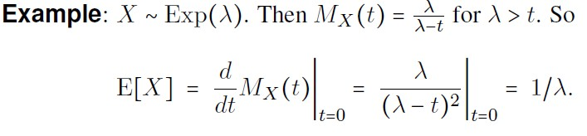
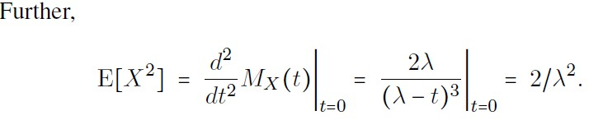
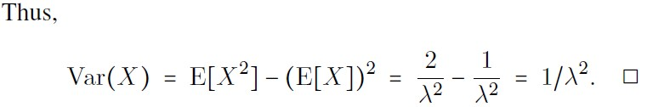

Slide 15
Summary
Those expectations were certainly great, eh? Especially LOTUS!
Next Time: Suppose you know everything about a random variable. But what can you say if you square it? Or take the log? We’ll look at arbitrary functions of RVs. These play important roles in simulation.

Slide 16
Computer Simulation
Module 2: Calculus, Probability, and Statistics Primers
Dave Goldsman, Ph.D.
Professor
Stewart School of Industrial and Systems Engineering
Functions of a Random Variable

Slide 17
Lesson Overview
Last Time: The lesson certainly had its moments! And mgf’s!
This Time: If you know everything about a RV, what can you say about functions of the RV?
This has huge implications throughout the course, e.g., in RV generation.

Slide 18

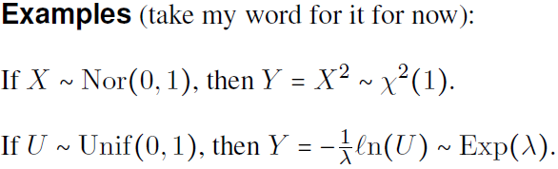

Slide 19
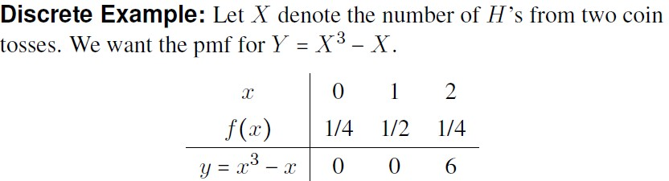
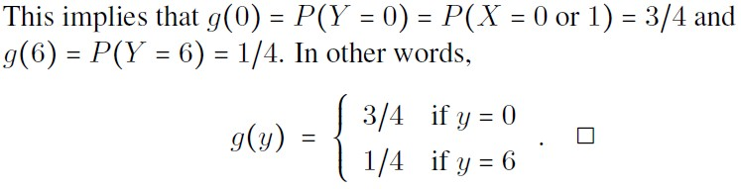

Slide 20
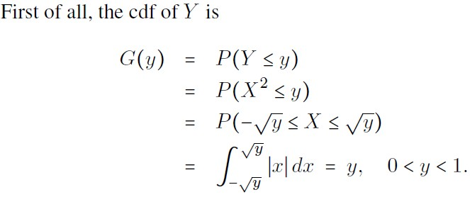

Slide 21
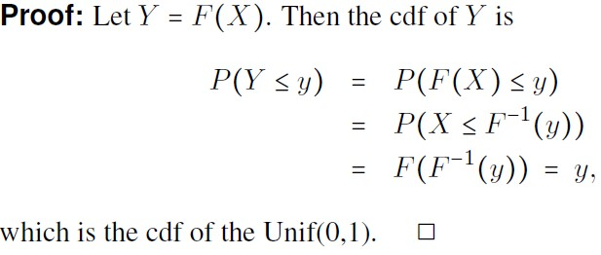

Slide 22

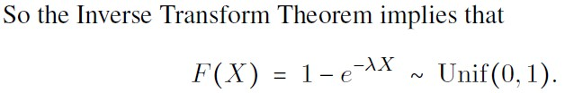
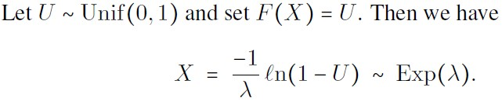

Slide 23
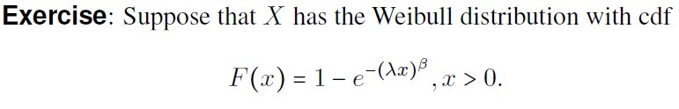
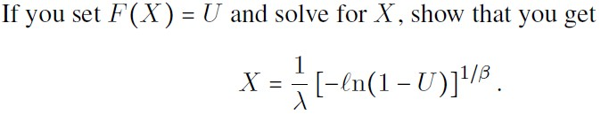
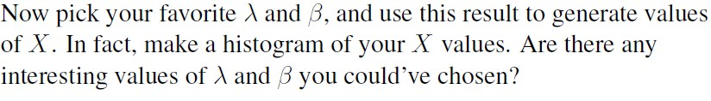

Slide 24
Bonus Time!
This has been a tough lesson so far.
But if you’re stout of heart, you can take a look at one more bonus result…
…or just skip ahead to the Summary. No harm, no foul!

Slide 25
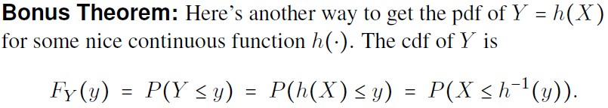
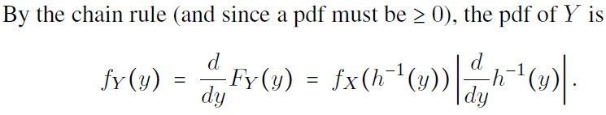

Slide 26


Slide 27
Summary
We looked at the distributions of functions of RVs. Along the way, we used the Inverse Transform Theorem to turn Unif(0,1)’s into arbitrary continuous distributions – very useful in simulation!
Next Time: If you liked one RV, you’ll simply love two! Joint RVs around the corner…

Slide 28
Computer Simulation
Module 2: Calculus, Probability, and Statistics Primers
Dave Goldsman, Ph.D.
Professor
Stewart School of Industrial and Systems Engineering
Jointly Distributed Random Variables

Slide 29
Lesson Overview
Last Time: Looked at functions of RVs and the Inverse Transform Method for generating RVs from Unif(0,1)’s.
This Time: We’ll review two- dimensional RVs that may be correlated with each other.
Think height and weight!
In simulation, think consecutive correlated waiting times.

Slide 30
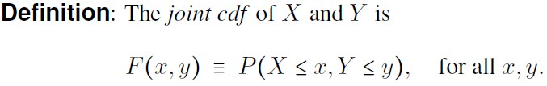
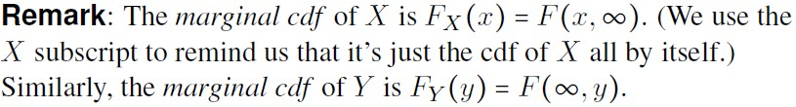

Slide 31

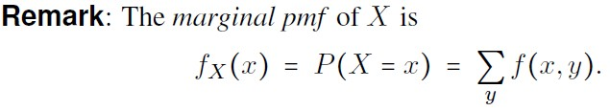
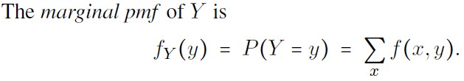
Notes:
Pmf is probability mass.

Slide 32
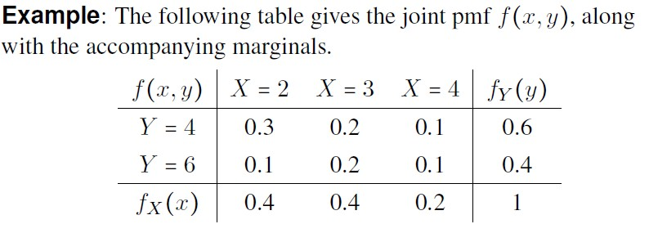

Slide 33

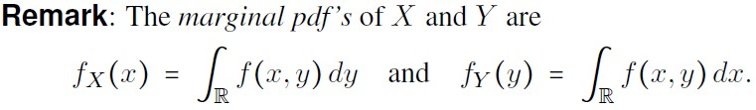

Slide 34
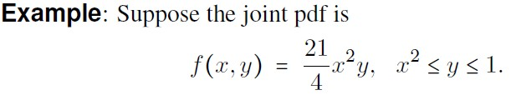
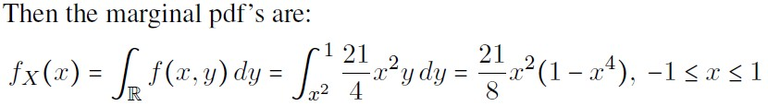
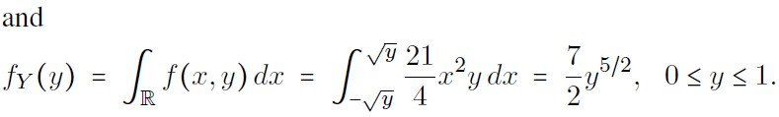

Slide 35
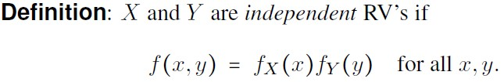
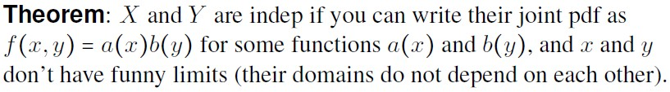

Slide 37


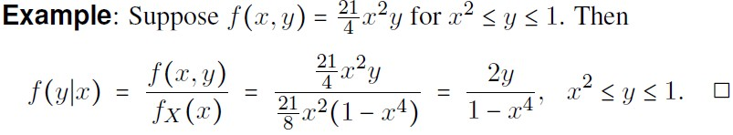

Slide 38
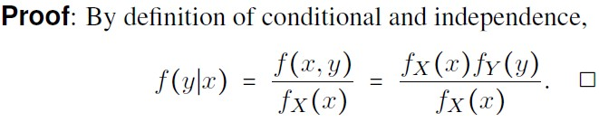

Slide 39
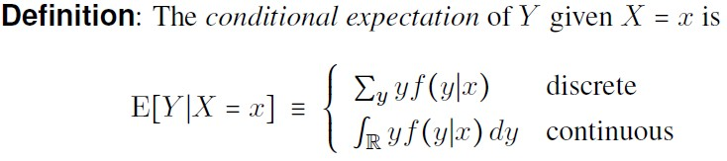
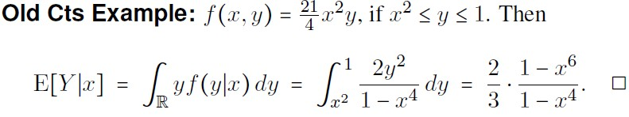

Slide 40
Summary
Did a lot of stuff: Joint pmf’s and pdf’s, independent, conditional distributions, and then conditional expectation. Whew!
Next Time: More fun with conditional expectation, including “double trouble”! (Probably the toughest lesson of Bootcamp.)

Slide 41
Computer Simulation
Module 2: Calculus, Probability, and Statistics Primers
Dave Goldsman, Ph.D.
Professor
Stewart School of Industrial and Systems Engineering
Conditional Expectation

Slide 42
Lesson Overview
Last Time: Joint pmf’s and pdf’s, independence, conditional distributions, and a touch of cond’l expectation.
This Time: Continue conditional expectation + several cool applications.
Tough lesson… let’s try to get through it together!

Slide 43
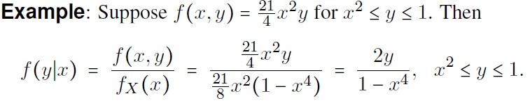

Slide 44
Double Trouble!
We’ll now look at the most- difficult concept of the Probability Bootcamp – double expectation.
Idea: the average expected value of all of the conditional expected values is the overall population average.
It’s sometimes a very useful tool when calculating such overall averages. Don’t Panic!

Slide 45
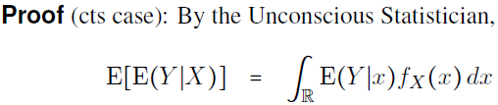





Slide 46
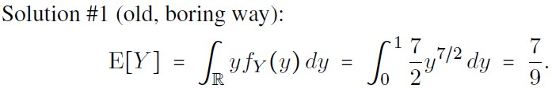
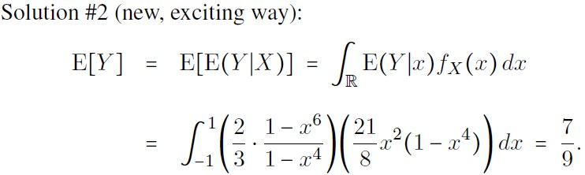

Slide 47
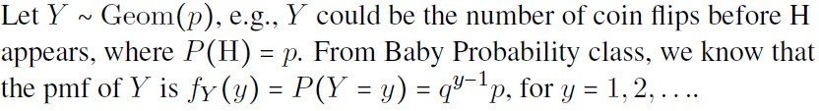
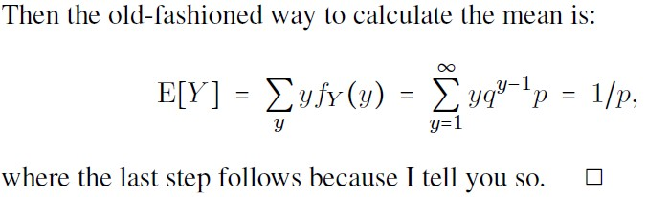

Slide 48
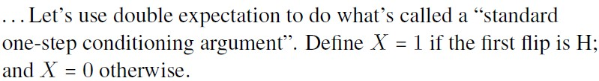


Slide 49



Slide 50



Slide 51


Slide 52



Slide 53



Slide 54
Summary
Studied conditional expectation along with a bunch of its applications, notably, double expectation and the standard conditioning technique.
Next Time: Covariance and correlation.
Congrats! All done with the hardest lesson!

Slide 55
Computer Simulation
Module 2: Calculus, Probability, and Statistics Primers
Dave Goldsman, Ph.D.
Professor
Stewart School of Industrial and Systems Engineering
Covariance and Correlation

Slide 56
Lesson Overview
Last Time: We kicked butt on conditional expectation and its applications.
This Time: We’ll talk about independence, covariance, correlation, and related results.
Correlation shows up all over the place in simulation.

Slide 57
Summary Placeholder
Talked about blah blah blah…
This completes Module 2, which went over blah blah blah
Coming up: Module 3 will blah blah blah

